Slide 1
Consumption and The Multiplier

Slide 2
Introduction
Two sector model of the goods market in the economy (no government sector, no foreign trade).
A closed economy:
  in which households exercise consumption demand for final goods and services; and
  Firms demand investment goods.

Slide 3
Introduction
In this economy
AD ≡ C + I
Theories to explain how and why households and firms make consumption and investment decisions.
Assuming investment in the economy is given.
Notes:
5

Slide 4
The Pre-Keynesian Consumption Function
In microeconomic theory, when households have a large number of goods and services to choose from, an important variable influencing the demand for a specific good is its price relative to all other goods and services:
Q_{d} = f(P), ceteris paribus

Slide 5
The Pre-Keynesian Consumption Function
When we construct a macroeconomic consumption function, we take the relative price of goods as given.
We focus on how households divide their expenditure (Y) between consumption of all goods and services and saving.
Y ≡ C + S

Slide 6
The Pre-Keynesian Consumption Function
Rewriting the identity, we can define planned savings as being that part of income which households do not intend to spend on consumption:
Y ≡ C + S
Or S ≡ Y - C

Slide 7
The Pre-Keynesian Consumption Function
In the pre-Keynesian era, the predominant view was that the rate of interest was the main variable influencing the division of income between C and S.
The pre-Keynesian savings and consumption functions can be written as:
S = f(r)
C = f(r)

Slide 8
The Keynesian Consumption Function
Keynes accepted that the rate of interest was a variable which influenced consumption decisions, but he believed that the level of income was more important.
C = f(Y)
S = f(Y)
‘The fundamental psychological law, upon which we are entitled to depend with great confidence . . . is that men are disposed, as a rule and on average, to increase their consumption as their income increases, but not by as much as the increase in their income’

Slide 9
The consumption function describes the relationship between consumer spending and income
C = C_{a} + by
Consumption spending, C, has two parts:
  C_{a} = autonomous consumption. This is the part of total consumption which does not vary with the level of income.
  by = income-induced consumption. The product of a fraction, b, called the marginal propensity to consume (MPC) and the level of income, y.
The consumption function is a line that intersects the vertical axis at C_{a}. It has a slope equal to b.

Slide 10
Consumption
function (C_{a} + by)
Demand
0
Output, y
The consumption function relates consumer spending to
the level of income.
Notes:
This slide identifies the three basic questions that all economists must ask in evaluating an existing economic society or evaluating what is desired for an economic society. This is he first of a sequence of four slides which examines what is being addressed by each question.

Slide 11
Consumption
function (C_{a} + by)
Demand
C_{a}
Output, y
0
The consumption function relates consumer spending to the level of income.

Slide 12
Consumption
function (C_{a} + by)
Demand
C_{a}
{
autonomous
consumption
Output, y
0
The consumption function relates consumer spending to the level of income.

Slide 13
Consumption
function (C_{a} + by)
Demand
slope b
C_{a}
{
autonomous
consumption
Output, y
0
The consumption function relates consumer spending to the level of income.

Slide 14
The Consumption Function
Although output is on the horizontal axis, output and income in this simple economy are identical
Output generates income that is all received by households.
As output rises by $1, consumption increases by the marginal propensity to consume (b) times $1

Slide 15
Marginal Propensity To Consume (MPC)
The MPC is always less than 1.
Suppose the MPC = .75
An increase in income of $100 would increase consumption by
bΔy
=.75 x $100
=$75

Slide 16
Marginal Propensity To Consume (MPC)
If a consumer receives a dollar of income, consumer will spend some of it and save the rest.
The fraction that the consumer spends is determined by the MPC.
The fraction of income that the consumer saves is determined by the marginal propensity to save (MPS)
The sum of the MPC and MPS is always 1
MPC+MPS=1

Slide 17
Changes in the Consumption Function
The level of autonomous consumption and the MPC can change causing movements in the consumption function
If the level of autonomous consumption is higher, it will shift the entire consumption function.
Changes in the marginal propensity to consume will change the slope of the consumption function.

Slide 18
Autonomous Consumption Changes
Increases in consumer wealth will cause an increase in autonomous consumption.
Consumer wealth consists of the value of stocks, bonds and consumer durables.
Increases in consumer confidence will increase autonomous consumption.

Slide 19
Movements Of The Consumption Function
Demand
C_{a}¹
C_{a}⁰
Output, y
An increase in autonomous consumption from C_{a}⁰ to C_{a}¹ shifts the entire consumption function.

Slide 20
Marginal Propensity To Consume Changes
Consumers’ perceptions of changes in their income affect their MPC
If consumers believe that an increase in their income is permanent, they will consume a higher fraction of the increased income than if the increase were believed to be temporary

Slide 21
Movements Of The Consumption Function
Slope b¹
Demand
Slope b
Output, y
An increase in MPC from b to b¹ increases the slope
of the consumption function.

Slide 22
The Multiplier - Introduction
We now need to introduce the Multiplier theory and investigate in more detail the process by which income or output changes when an autonomous change occurs in any of the components of aggregate demand.

Slide 23
The Multiplier - Brief History
The concept was first developed by Richard Kahn.
Early theory was employment multiplier.
Keynes first made use of Kahn’s multiplier in 1933, when he discussed the effects of an increase in government spending of £500 (a sum assumed to be just sufficient to employ a man for one year in the construction of public works)

Slide 24
The Multiplier - Brief History
Keynes wrote:
  ‘If the new expenditure is additional and not merely in substitution for other expenditure, the increase of employment does not stop there. The additional wages and other incomes paid out are spent on additional purchases, which in turn lead to further employment . . . the newly employed who supply the increased purchases of those employed on the new capital works will, in their turn, spend more, thus adding to the employment of others; and so on’

Slide 25
The Multiplier - Brief History
By the time of the publication of the General Theory in 1936, Keynes had placed the multiplier at the heart of how an economy can settle into an underemployment equilibrium.
In the General Theory, Keynes focused attention on the investment multiplier, explaining how a collapse in investment and business confidence can cause a multiple contraction of output.

Slide 26
The Multiplier In Action
From this, it was only a short step to suggest how the government spending multiplier might be used to reverse the process.
Example:
  Let’s assume that the MPC is 0.8 at all levels of income (MPS = 0.2)
  Whenever income increases by $10, consumption increases by $8 and $2 is saved.
  We assume that prices remain constant, and that a margin of spare capacity and unemployed labour exists which the government wishes to reduce.

Slide 27
The Multiplier In Action
Suppose the government increases public expenditure by $1 million, keeping taxation at its existing level.
The government could increase transfer payments. Alternatively, the government might wish to invest in public works or social capital (e.g. road construction).

Slide 28
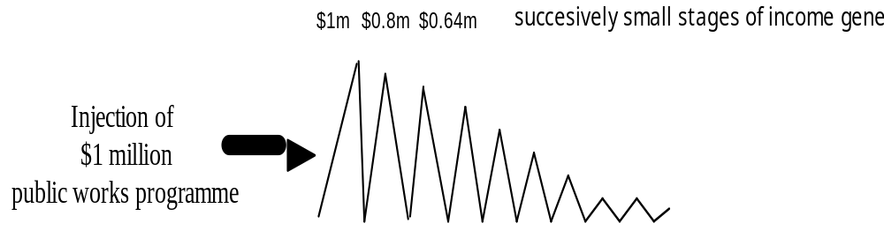
Initial increase in income large
Households spend 0.8 of their increase in income on consumption ($800,000)
Further stages of income generation occur, with each successive stage being smaller than the previous one.

Slide 29
The Multiplier In Action
The eventual increase in income resulting from the initial injection is the sum of all the stages of income generation.
The value of the government spending multiplier =
Change in income
Change in government spending
or
k = ΔY
Δ G

Slide 30
The Multiplier In Action
Providing that saving is the only leakage of demand, the value of k depends upon the MPC.
The formula for the multiplier in this model is:
k = 1
1 - b
(where b = MPC)
The larger the MPC, the larger the value of the multiplier.
In our model, the value of the multiplier is 5 - an initial increase in public spending will subsequently increase income by $5 million.

Slide 31
Multiplier and Economic Policy
Implications are that it is possible to use discretionary fiscal policy to control or influence the level of aggregate demand.
Monetarists would dispute the beneficial effects - would point to the ‘crowding out’ effects of a widening budget deficit.

